Slide 1



Module #6– Software Integration testing
Software Testing
Topic #1 – Software Integration Testing
Instructor: Jerry Gao, Ph.D., Professor
San Jose State University
Notes:
From this session, we start to Module #2 on Software Testing Fundamentals.
In this module, we cover the basics of software testing, including the following subjects:
Topic #1 - Software Problem Management
Topic #2 - Software Test Design
Topic #3 - Software Test Management

Slide 2
Module #6– Software Integration testing
Software Testing
What Is Software Integration Testing?
Why do we perform Integration Testing ?
Software Integration Strategy
Integration Testing Approaches
Summary
Notes:
This is the first package in Module 3 for Software Testing Class. It provides an introduction to software white-box testing. It covers the following
What is white-box testing?
Why Is white-box testing important?
Who does white-box testing?
White-box testing focuses
White-box testing coverage

Slide 3
Module #6– Software Integration testing
Software Testing
What is software integration testing?
Definition: Testing activities that integrate software components together to form a complete system. To perform a cost-effective software integration, integration test strategy, integration test set are needed.
What are the major testing focuses ?
Interfaces between modules (or components)
Integrated functional features
Interacting protocols and messages
System architectures

Slide 4
Module #6– Software Integration testing
Software Testing
Why do we need Integration Testing ?
Unit tests only test the unit in isolation
Many failures result from faults in the interaction of subsystems
Often many Off-the-shelf components are used that cannot be unit tested
Without integration testing the system test will be very time consuming
Failures that are not discovered in integration testing will be discovered after the system is deployed and can be very expensive.

Slide 5
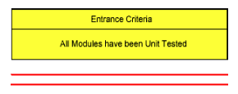
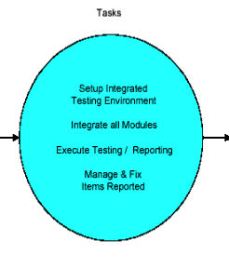
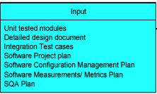

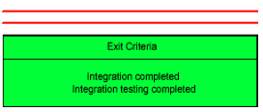
Module #6– Software Integration testing
Software Testing
Integration Testing Focuses
Notes:
White-box software testing focuses on the following areas:
– Program control/execution paths → to make sure that executable program control flows
can be correctly executed.
Program data → to make sure that program data parameters and values are properly set-up and
accessed.
– Program branches → to make sure that program branches are correctly implemented and exercised.
- Program logics → to make sure that the diverse program logics are correctly implemented and computed.

Slide 6
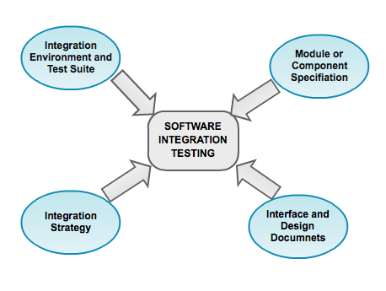
Module #6– Software Integration testing
Software Testing
What do we need for Integration Testing
Who performs Integration Testing ?
Developers and Test Engineers
Notes:
Why white-box software testing is important?
The major purpose is to achieve pre-defined program code coverage for white-box testing. Here are the typical objectives and reasons:
– Cover different program control flows and execution paths
Cover different program data and their value set-up and usage
Cover various program branches and logics
Uncover the deadlock program codes and cases in software

Slide 7
Module #6– Software Integration testing
Software Testing
Software Integration Strategy
What is software integration strategy ?
Software test strategy provides the basic strategy and guidelines to test engineers to perform software testing activities in a rational way. Software integration strategy usually refers to
An integration sequence (or order) to integrate different parts (or components) together.
A test model is needed to support the definition of software integration test strategies.
Notes:
White-box software testing focuses on the following areas:
– Program control/execution paths → to make sure that executable program control flows
can be correctly executed.
Program data → to make sure that program data parameters and values are properly set-up and
accessed.
-

Slide 8
Module #6– Software Integration testing
Software Testing
Test Models in Integration Testing
control flow graph
object-oriented class diagram
scenario-based model
component-based integration model
architecture-based integration model
Jerry Gao Ph.D.
Notes:
White-box software testing focuses on the following areas:
– Program control/execution paths → to make sure that executable program control flows
can be correctly executed.
Program data → to make sure that program data parameters and values are properly set-up and
accessed.
-

Slide 9
Module #6– Software Integration testing
Software Testing
Traditional Software Integration Strategy
There are two groups of software integration strategies: → Non Incremental software integration → Incremental software integration Non Incremental software integration: → Big band integration approach Incremental software integration: →Top- down software integration → Bottom-up software integration → Sandwich integration
Jerry Gao Ph.D.
Notes:
White-box software testing focuses on the following areas:
– Program control/execution paths → to make sure that executable program control flows
can be correctly executed.
Program data → to make sure that program data parameters and values are properly set-up and
accessed.
-

Slide 10
Module #6– Software Integration testing
Software Testing
Non Incremental Software Integration
Big band Integration Approach
Combine (or integrate) all parts at once.
Test A
Test B
Test C
Test
A, B, C, D,
E, F, G
Test D
Test E
Test F
Jerry Gao Ph.D.
Test G
Notes:
White-box software testing focuses on the following areas:
– Program control/execution paths → to make sure that executable program control flows
can be correctly executed.
Program data → to make sure that program data parameters and values are properly set-up and
accessed.
-

Slide 11
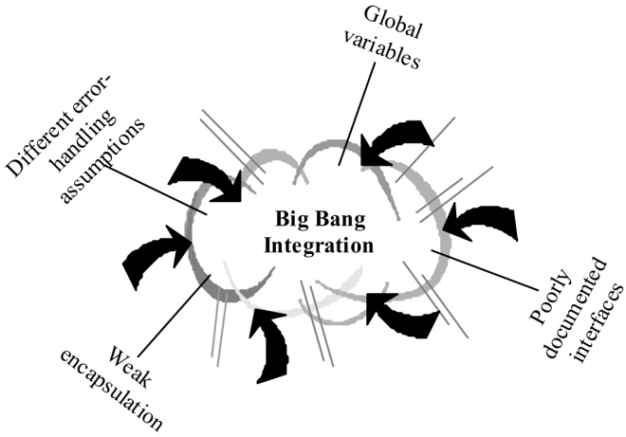
Module #6– Software Integration testing
Software Testing
Non Incremental Software Integration
Big Band Integration Approach
Advantages:
simple
Disadvantages:
hard to debugging, not easy to isolate errors
not easy to validate test results
impossible to form an integrated system
Jerry Gao Ph.D.
Notes:
White-box software testing focuses on the following areas:
– Program control/execution paths → to make sure that executable program control flows
can be correctly executed.
Program data → to make sure that program data parameters and values are properly set-up and
accessed.
-

Slide 12
Module #6– Software Integration testing
Software Testing
Test Stubs and Test Drivers
What are software test stubs? →Software test stubs are programs which simulate the behaviors of software components (or modules) that are the dependent modules of a under test module. Typical stubs relates to a under test module in the following ways:
UT Module
UT Module
UT Module
Functional call
with input
parameters only
Functional call
without parameters
and return values
Functional call
with parameters and return values
Stub
Stub
Stub
Dependent
Module
Dependent
Module
Dependent
Module
Jerry Gao Ph.D.
Notes:
White-box software testing focuses on the following areas:
– Program control/execution paths → to make sure that executable program control flows
can be correctly executed.
Program data → to make sure that program data parameters and values are properly set-up and
accessed.
-

Slide 13
Module #6– Software Integration testing
Software Testing
Test Stubs and Test Drivers
What are software test drivers? →Software test drivers are programs which simulate the behaviors of software components (or modules) that are the control modules of a under test module. Typical drivers relates to a under test module in the following ways:
UT Module
UT Module
UT Module
Functional call
with input
parameters only
Functional call
without parameters
and return values
Functional call
with parameters and return values
Driver
Driver
Driver
Control
Module
Control
Module
Control
Module
Jerry Gao Ph.D.
Notes:
White-box software testing focuses on the following areas:
– Program control/execution paths → to make sure that executable program control flows
can be correctly executed.
Program data → to make sure that program data parameters and values are properly set-up and
accessed.
-

Slide 14
Module #6– Software Integration testing
Software Testing
Top-down Integration Approach
Idea:-Modules are integrated by moving downward through the control structure.
Modules subordinate to the main control module are incorporated into the system
in either a depth-first or breadth-first manner.
Test
A, B, C, D,
E, F, G
Test A
Test A, B, C, D
Layer I
Layer I + II
All Layers
Notes:
White-box software testing focuses on the following areas:
– Program control/execution paths → to make sure that executable program control flows
can be correctly executed.
Program data → to make sure that program data parameters and values are properly set-up and
accessed.
-

Slide 15
Module #6– Software Integration testing
Software Testing
Top-down Integration Approach
Integration process (five steps):
The main control module is used as a test driver, and the stubs
are substituted for all modules directly subordinate to the main
control module.
Subordinate stubs are replaced one at a time with actual modules.
Tests are conducted as each module is integrated.
On completion of each set of tests, another stub is replaced with
the real module.
Regression testing may conducted.
Notes:
White-box software testing focuses on the following areas:
– Program control/execution paths → to make sure that executable program control flows
can be correctly executed.
Program data → to make sure that program data parameters and values are properly set-up and
accessed.
-

Slide 16
Module #6– Software Integration testing
Software Testing
Top-Down Integration
Main
1
3
2
M1
M2
M3
4
5
6
7
M4
M5
M6
M7
8
Select the integration sequence:
Depth-First
Breadth-First
- Left --> Right
- Right --> Left
M8
Notes:
White-box software testing focuses on the following areas:
– Program control/execution paths → to make sure that executable program control flows
can be correctly executed.
Program data → to make sure that program data parameters and values are properly set-up and
accessed.
-

Slide 17
Module #6– Software Integration testing
Software Testing
Top-Down Integration
Integration Order: Breadth-First (Left Order) IS: Integrated System Mi ’: software stub for Module Mi. Step #1: IS = Main + M1 (need: M2’, M3’, M4’ and M5’) Step #2: IS = IS + M2 (need: M4’, M5’, M6’, and M3’) Step #3: IS = IS + M3 (need: M4’, M5’, M6’, and M7’) Step #4: IS = IS + M4 (need: M5’, M6’,and M7’) Step #5: IS = IS + M5 (need: M8’, M6’, and M7’) Step #6: IS = IS + M6 (need: M7’, and M8’) Step #7: IS = IS + M7 (need: M8’) Step #8: IS = IS + M8
Notes:
White-box software testing focuses on the following areas:
– Program control/execution paths → to make sure that executable program control flows
can be correctly executed.
Program data → to make sure that program data parameters and values are properly set-up and
accessed.
-

Slide 18
Module #6– Software Integration testing
Software Testing
Pros and Cons of Top-down Integration Approach
Pros
Test cases can be defined in terms of the functionality of the system (functional requirements)
No drivers needed
Cons
Writing stubs is difficult: Stubs must allow all possible conditions to be tested.
Large number of stubs may be required, especially if the lowest level of the system contains many methods.
Some interfaces are not tested separately.
Notes:
White-box software testing focuses on the following areas:
– Program control/execution paths → to make sure that executable program control flows
can be correctly executed.
Program data → to make sure that program data parameters and values are properly set-up and
accessed.
-

Slide 19
Module #6– Software Integration testing
Software Testing
Bottom-Up Software Integration
Idea:- Modules at the lowest levels are integrated at first, then by moving upward through the control structure.
Test E
Test B, E, F
Test F
Test
A, B, C, D,
E, F, G
Test C
Test G
Test D,G
Notes:
White-box software testing focuses on the following areas:
– Program control/execution paths → to make sure that executable program control flows
can be correctly executed.
Program data → to make sure that program data parameters and values are properly set-up and
accessed.
-

Slide 20
Module #6– Software Integration testing
Software Testing
Bottom-Up Software Integration
Integration process (five steps):
Low-level modules are combined into clusters that perform a specific software sub-function.
A driver is written to coordinate test case input and output.
Test cluster is tested.
Drivers are removed and clusters are combined moving upward in the program structure.
Notes:
White-box software testing focuses on the following areas:
– Program control/execution paths → to make sure that executable program control flows
can be correctly executed.
Program data → to make sure that program data parameters and values are properly set-up and
accessed.
-

Slide 21
Module #6– Software Integration testing
Software Testing
Bottom-Up Software Integration
Main
7
9
8
M1
M2
M3
4
5
6
3
M4
M5
M6
M7
1
2
M8
Notes:
White-box software testing focuses on the following areas:
– Program control/execution paths → to make sure that executable program control flows
can be correctly executed.
Program data → to make sure that program data parameters and values are properly set-up and
accessed.
-

Slide 22
Module #6– Software Integration testing
Software Testing
Bottom-Up Software Integration
Integration Order: Breadth-First (Left Order) IS: Integrated System Mi”: software driver for Module Mi. Step #1: IS1 = M8 + M4 (need: M5” and M1”) Step #2: IS1 = IS1 + M5 (need: M1”) Step #3+4: IS1 = IS1 + M1 (need: Main”) Step #5: IS2 = M2 + M6 (need: Main”) Step #6: IS3 = M3 + M7 (need: Main”) Step #7: IS = IS1 + Main (need: M2’, M3’) Step #8: IS = IS + IS2 (Need: M3’) Step #9: IS = IS + IS3
Notes:
White-box software testing focuses on the following areas:
– Program control/execution paths → to make sure that executable program control flows
can be correctly executed.
Program data → to make sure that program data parameters and values are properly set-up and
accessed.
-

Slide 23
Module #6– Software Integration testing
Software Testing
Pros and Cons of Bottom-Up Integration Approach
Cons:
Tests the most important subsystem (user interface) last
Drivers needed
Pros:
No stubs needed
Useful for integration testing of the following systems
Object-oriented systems
Real-time systems
Systems with strict performance requirements.
Notes:
White-box software testing focuses on the following areas:
– Program control/execution paths → to make sure that executable program control flows
can be correctly executed.
Program data → to make sure that program data parameters and values are properly set-up and
accessed.
-

Slide 24
Module #6– Software Integration testing
Software Testing
Integration Example
M1
M2
M5
M3
M7
M6
M4
M8
M9
Please find the integration test order using the top-down approach.
Please find the integration sequence using the bottom-up approach.
Notes:
White-box software testing focuses on the following areas:
– Program control/execution paths → to make sure that executable program control flows
can be correctly executed.
Program data → to make sure that program data parameters and values are properly set-up and
accessed.
-

Slide 25
Module #6– Software Integration testing
Software Testing
Object-Oriented Software Integration
There are a number of proposed integration test strategies for object-oriented software. One of them is known as Class Test Order. What is class test order? - It is a class test sequence order for a class library or an OO program. It uses a class relation diagram as its class integration test model. This class test order provides a unit test sequence for classes in a class library
Notes:
White-box software testing focuses on the following areas:
– Program control/execution paths → to make sure that executable program control flows
can be correctly executed.
Program data → to make sure that program data parameters and values are properly set-up and
accessed.
-

Slide 26
Module #6– Software Integration testing
Software Testing
A Class Test Order for Object-Oriented Programs
ButtonList
Sensor
AG
AG
AS
AS
AS
AS
Button
AS
Event
Scene
AS
AS
I
I
TextButton
ButtonState
World
AG
I
AS
AS
AS
I
Subject
Control
I
CanvasRep
Canvas
AS
AS
I
AS
AS
AS
MonoScene
InstructorItr
ControlState
Notes:
White-box software testing focuses on the following areas:
– Program control/execution paths → to make sure that executable program control flows
can be correctly executed.
Program data → to make sure that program data parameters and values are properly set-up and
accessed.
-

Slide 27
Module #6– Software Integration testing
Software Testing
A Class Test Order for Object-Oriented Programs
ButtonList
Sensor
AG
AG
AS
AS
AS
AS
Button
AS
Event
Scene
AS
AS
I
I
TextButton
ButtonState
World
AG
I
AS
AS
AS
I
Subject
Control
I
CanvasRep
Canvas
AS
AS
I
AS
AS
AS
MonoScene
InstructorItr
ControlState
AG
Notes:
White-box software testing focuses on the following areas:
– Program control/execution paths → to make sure that executable program control flows
can be correctly executed.
Program data → to make sure that program data parameters and values are properly set-up and
accessed.
-

Slide 28
Module #6– Software Integration testing
Software Testing
A Class Test Order for Object-Oriented Programs
4
3
4.1
ButtonList
Sensor
AG
3.4
AG
3.3
AS
AS
AS
AS
Button
4.2
AS
Event
Scene
AS
AS
I
3.1
I
2
5
TextButton
ButtonState
3.2
World
AG
I
AS
AS
AS
I
1
I
1
2
1.1
Subject
5.2
Control
I
CanvasRep
Canvas
AS
AS
I
AS
AS
AS
4
MonoScene
1.2
InstructorItr
5
ControlState
5.1
AG
Notes:
White-box software testing focuses on the following areas:
– Program control/execution paths → to make sure that executable program control flows
can be correctly executed.
Program data → to make sure that program data parameters and values are properly set-up and
accessed.
-

Slide 29
Module #6– Software Integration testing
Software Testing
Please fine the class test order for the following
C0
C1
I
AG
AS
C5
C2
AS
C8
AS
AS
I
AG
AS
C3
C7
C6
AS
AS
C4
Notes:
White-box software testing focuses on the following areas:
– Program control/execution paths → to make sure that executable program control flows
can be correctly executed.
Program data → to make sure that program data parameters and values are properly set-up and
accessed.
-

